Slide 1
Food Giant Flyer Creator
Kendrick Hagerman
Computer Science Project - COT6931
Notes:
Hello, I’m Kendrick Hagerman and this is my PowerPoint Presentation for my Capstone, the Food Giant Flyer Creator
This is for COT 6931
I am going to describe the work that went into the implementation and testing phase of the product

Slide 2
Overview
Background
Flyer Comparison
Implementation Steps
Deploying to Azure
Testing and Documentation
Program Pictures
Summary
Notes:
This is my presentation overview, I’ll keep this quick so we can start getting into the presentation
Background
Flyer Comparison
Implementation Steps
Deploying to Azure
Testing and Documentation
Program Pictures
Summary

Slide 3



Background
Project is for the Food Giant
Problem came up when talking about work with friend
Stores have issue with excess inventory
No way to quickly promote store-specific sale items
Notes:
This project is for the Food Giant grocery store chain
“Food Giant actually consists of multiple grocery stores, Food Giant, Piggly Wiggly, Pic N Save, Mad Butcher, Save Mart, and Citronelle Markets
They also cover 8 states” – Reference http://www.foodgiant.com/locations
During a talk with a friend of mine, who is a district manager at Food Giant, he mentioned his company had tried to work with a third-party tech firm to get an application developed, but it fell through
I ended up talking to him about what the application needed to do, and decided on completing it for my Capstone Project
This project’s objective is to allow store managers at food giant to create and distribute customized sale flyers for excess goods to help sale them. This is to both reduce the cost of eliminating excess inventory before it loses the company income by becoming expired goods and earn more revenue for the store .
This problem will be solved by creating a Graphical User Interface (GUI) program designed for District and Store Managers.
The program, named the Food Giant Flyer Creation program, will allow these Managers to generate customized flyers for their store that they can print and distribute to customers.
Currently, they have no way to create flyers in this fashion. The only way customers can find out about store-specific sales is to be at the store.
These custom flyers will allow a store to more easily reach and inform their customer base about sales, which should draw in more customers, potentially increasing revenue.
This program is designed for Managers with very little experience with computers.

Slide 4
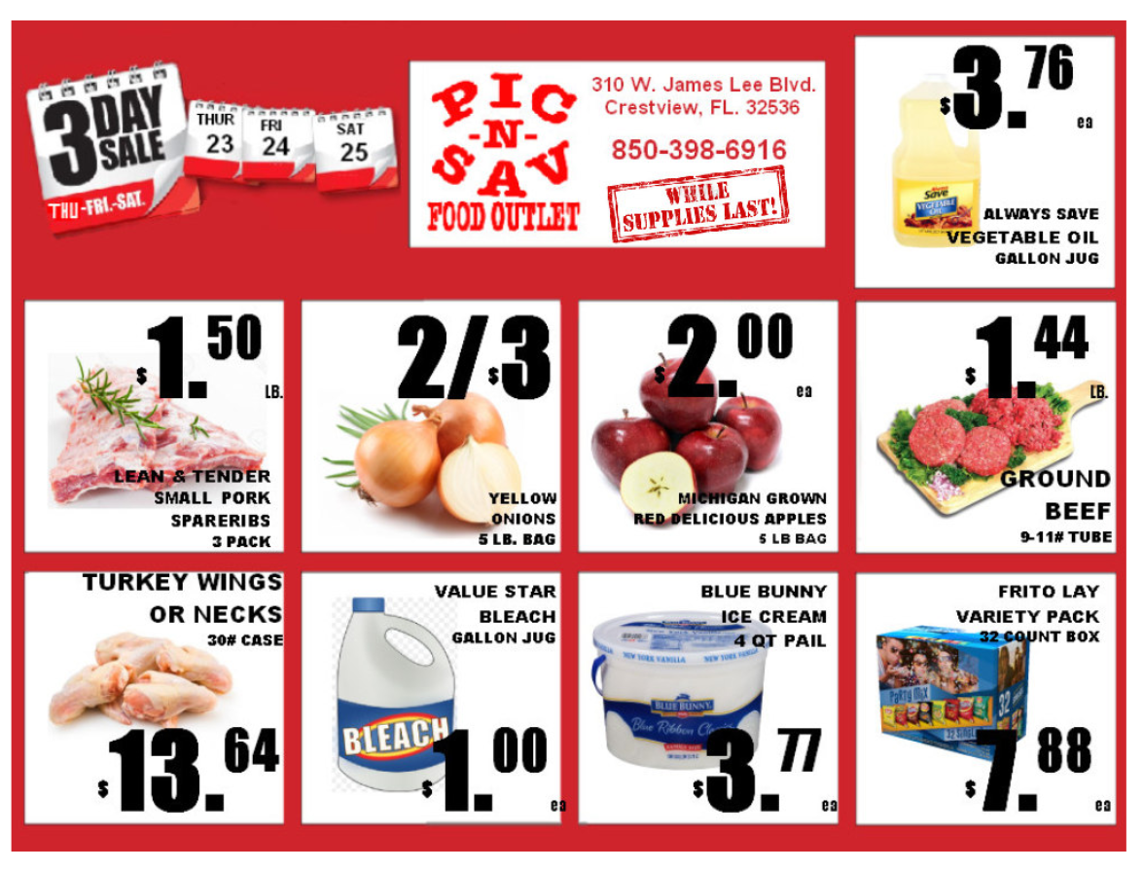
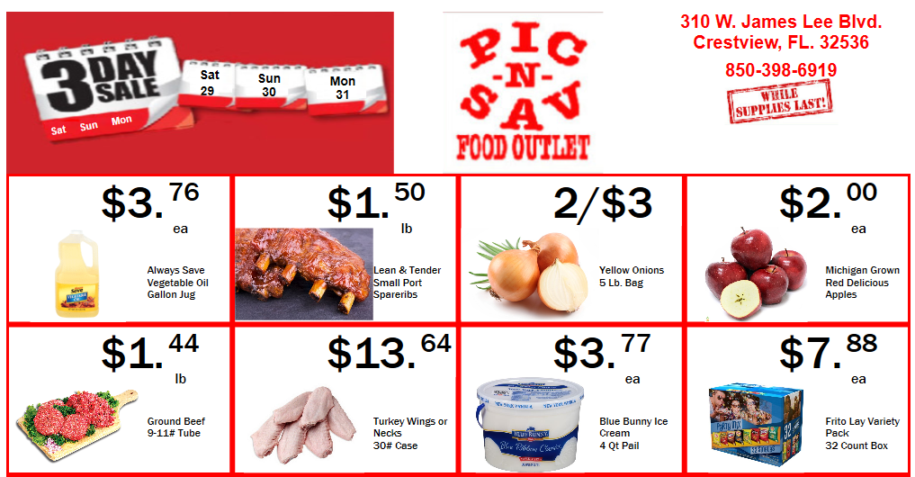
Flyer Comparison Picture
Notes:
Essentially, All my client wanted is for their store managers to be able to create flyers that look like the standard store flyers.
Here’s a picture of what they have on the right, with what I did on the left. We have multiple demos of the product and they decided they liked the less bold font, and didn’t like how text could be obscured around the image, so I made those changes
There is much more work that can be done to make things more aesthetically pleasing, but this was more of a nice to have, not an immediate SRS requirement
This is still something planned for future versions! But I explained it’s best I give them a stable product to initially use and provide suggestions that way
A saying I’ve heard is if the customer asks for a Ford, don’t give them a Ferrari. They wanted a basic flyer outline, so that’s what I provided

Slide 5
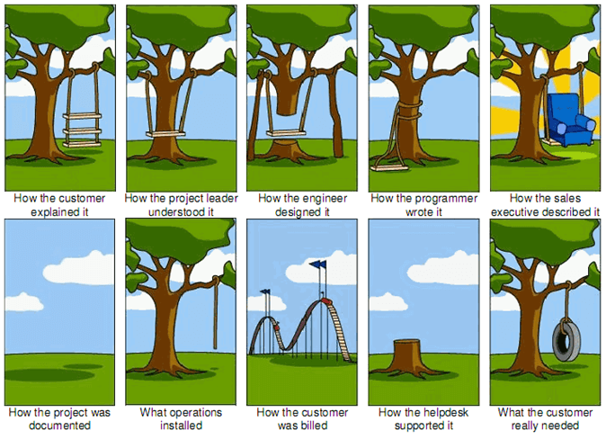
Tire Swing
Notes:
This is also because my customer was not sure of what they wanted the software to do, which leads to me showing them what I think they want.
This is the dilemma of every software developer and engineer, as shown by this classic cartoon
Reference: https://www.tamingdata.com/wp-content/uploads/2010/07/tree-swing-project-management-large.png

Slide 6
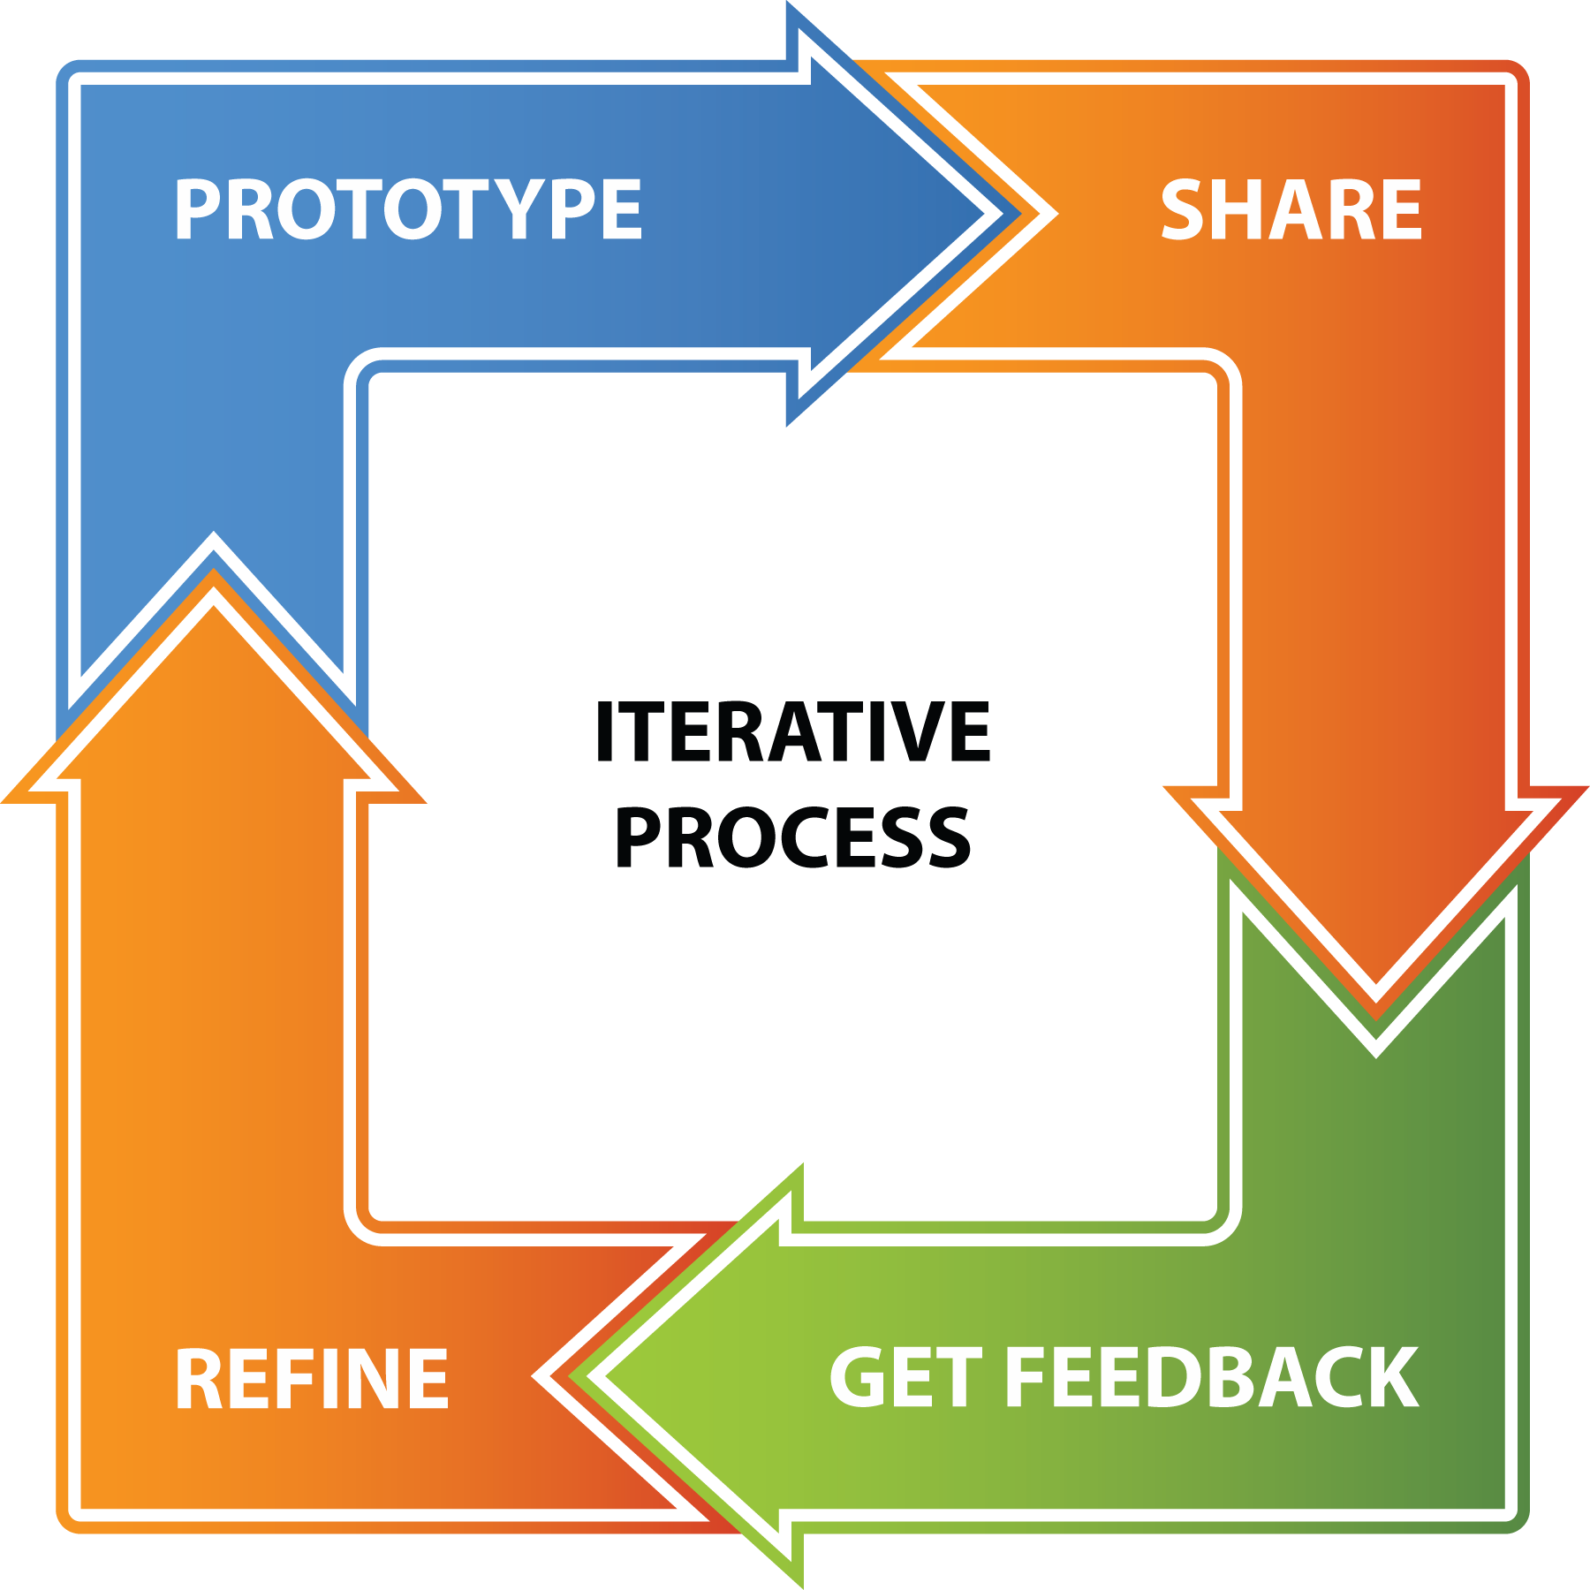
Implementation Steps
Worked in Sprints
Used design document/prototype source code
Translated SRS requirements into User Stories
Updated existing test cases/added new ones
Notes:
This was my implementation for the product
I created sprints where I broke the SRS items into User Stories and decided on how many I could do every sprint
I updated my test cases as I developed the program, and tested previous test cases throughout the development, especially on virtual machines
This was an iterative process that was done every sprint, allowing me to focus on one SRS item at a time, reducing the chance of me breaking other functionality during development

Slide 7
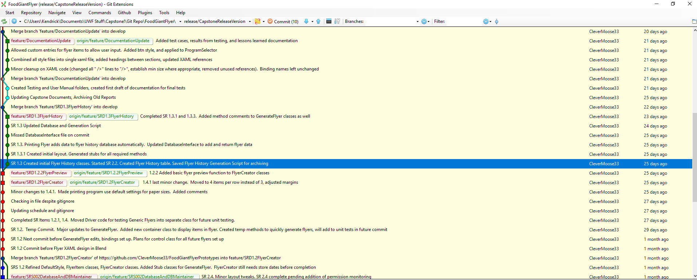

Implementation Steps 2
Visual Studio
MVVM Framework
Caliburn
Tracked Git Commits to SRS Items
Notes:
For creating the product, I used visual studio 2015 just like my prototype and used my design document
I started a new project and did not copy over my classes from the prototype
Still, there were some methods in my prototype that were fully applicable to my final product, so those were refactored and copied over
I stuck with MVVM and Caliburn for the final project and made various improvements in how my software was organized throughout the project
I created a SQLite Database in Visual Studio and implemented application-level access to the database via my database interface class, which has all my database queries stored in one located
Overall my implementation as very close to my design documents, which was encouraging
Still used Git Extensions to track commits to SRS items where applicable.
Only working on project by myself, but my degree is for software engineering, so good software engineering practices are required

Slide 8
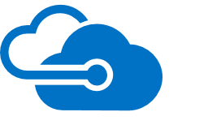

Getting the project online
Using Azure
Set up domain accounts
Configured the Virtual Machine
Biggest room for improvement – moving to ASP.NET and Razor
Notes:
I used Microsoft Azure to generate a virtual machine to run the program. Reference: https://azure.microsoft.com/
This was so we could keep the files under source control and backed up as well
First step was getting the machine set up to run the program
This was pretty simple, but still took some time to install SQL Express, and I struggled for 30 minutes to an hour or so getting the right add-ons installed
Made a machine image to prevent me from redoing work
Then, it was setting up user accounts, and making sure people could connect to the service.
Still, I feel like this entire section should be done better
The program would be much more efficient and easier to deploy and access as a web app, this is something I plan to do after this semester by embedding my C# code in an ASP project using Razor, or at least, that’s my current idea
Going from MVVM to MVC shouldn’t require that much effort, or at least I hope not, think I’ll be spending some time designing and estimating this part before jumping into it

Slide 9
Testing and Documentation
Kept test document up to date
Used Virtual Machine for testing
Wrote User’s Manual/System Requirements Document
Notes:
Finally, I performed continuous testing on the software and re-ran all tests on the Virtual Machine to ensure I had all system requirements written down
Added new test cases every time I finished a relevant SRS item
Created Test Case document, User’s Manual and System Requirements document
The two latter items are SRS requirements, and have also been checked into the Git Source Control
Found many various issues during testing, and documented those to send to Dr. Lohr to show how valuable testing was
This is a shorter section, but don’t think it’s any less important than the previous slides.
Properly testing and documenting the software was extremely valuable for ensuring quality, even with a single developer

Slide 10
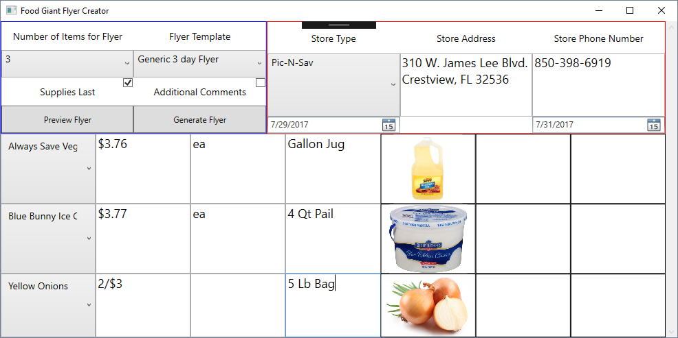
Flyer Pictures – Flyer Creator
Notes:
Here’s some pictures of the user interfaces. I’d really recommend you look at my video on YouTube, discussed at the end of the presentation, to get a better understanding of how these programs function.
Note: I did not include it in the PowerPoint since it would make the file bloated, and it is easy to access as long as you have an internet connection
This is the flyer creator. This is the main class for the Food Giant Flyer Creator program and where most of the effort went in to
I’ve worked this class into a step by step program, to make it easier to understand for new users (that’s why there’s some color coding going on)
Each item is it’s own section, and can be shown individually to users so they are not overwhelmed by the amount of information being shown to them
I did not see a point in separating the parts for the presentation though, since it’s better to see as a whole in this PowerPoint
Every visual element is linked to a Resource Dictionary shared across all views, so making aesthetic updates is quick and covers every applicable control
The Flyer Items read data from the SQLite database and allow the user to select from any added item. They can then input the price, item size, item description and select the image that goes onto the flyer
They can also preview the flyer before generating a flyer to better understand how it will look
Clicking the Generate Flyer button sends all of this data to the Generic Flyer Class, the selected Flyer Template, and populates that class into a printable format for the user

Slide 11
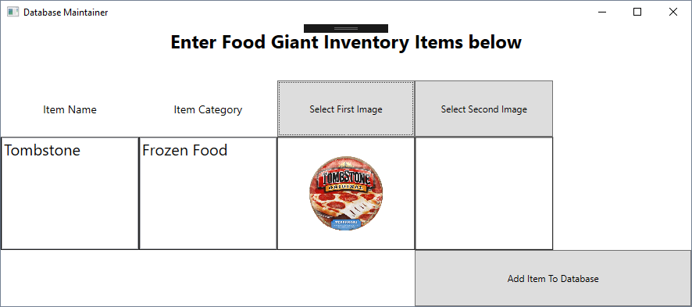
Flyer Pictures – Database Maintainer
Notes:
This is the Database Maintainer
This allows the customer to add items to the database using a simple UI interface instead of directly editing the database
I used the standard SqlConnection and SqlCommand objects in C# along with input validation in order to protect the database against SQL Injection
Each field is validated before the item is added, and there is an additional query in my database interface file that makes sure they are not adding a duplicate file
I have code ready to allow the customer to delete/modify items as well, but that was not implemented this version

Slide 12
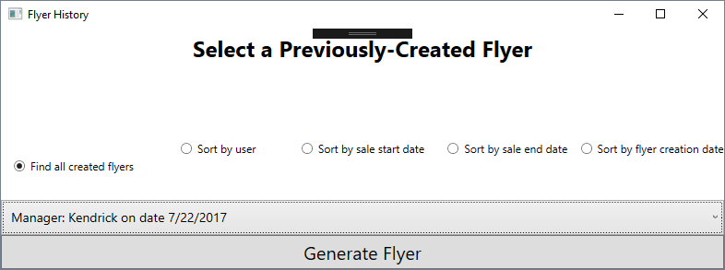
Flyer Pictures – Flyer History
Notes:
This is the flyer history
Every time a flyer is printed, the data for the flyer is transformed into text and saved inside the database
This program allows a district manager to search the database for previously-created flyers and regenerate them to see what their store managers have did
Clicking the generate flyer pulls the data out of the database and populates the Generic Flyer class to recreate the flyer. Again, please look at my video demo if you’d like more details

Slide 13
Summary
Notes:
So, in conclusion, I’ve explained my client’s problem domain implementation and testing work that went into delivering them a product
I outlined the project’s purpose and explained why software engineering was important
I described my implementation work and room for improvement
I discussed the importance of proper software documentation a testing
Finally, I gave some basic examples of the product
Please look at my capstone video on Youtube at https://youtu.be/CuRSOrhd9bA
I think this application should help Food Giant use more modern ways to sale products
Maybe a future option could be sending the completed flyers to subscribing customers’ smart phones, just a thought
Overall, I am happy with how things turned out, and hope to continue working on the software in the future, past my Master’s degree
Thank you.

Slide 14
References
YouTube Presentation Link
Azure - https://azure.microsoft.com/
Tire Swing Comic - https://www.tamingdata.com/wp-content/uploads/2010/07/tree-swing-project-management-large.png

